Slide 1



Power of data. Simplicity of design. Speed of innovation.
Hands on Introduction to Apache Spark for
Data Engineers, Data Scientists, and Developers at Metlife
Notes:
Welcome to ….
Be sure to document on the whitebioard the urls
for DSWB
for lab Notebooks ibm.box.xom/IntroApacheSpark Passsword = IBMSpark
for the POT Survey
Note the survey will revela the instructor notebooks upon completion.

Slide 2
Agenda
9 am – 10 am | Kickoff, Apache Spark Overview
10:00am – 11:00am | Lab 1, Hello Spark - Hand on exercise
11:00 am – 12:00pm | Apache Spark SQL Overview
12:00 pm – 1pm | Lunch
1pm – 2pm | Lab 2, Spark SQL - Hands on exercises
2pm – 3pm | Overview of Data Science & Machine Learning w/ Apache Spark
3pm – 4pm | Lab 3, Machine Learning w/ Spark – Hands on exercises
4pm – 4:30pm | Wrap up – Feedback from attendees

Slide 3



Introductions: Instructor
Joseph Kambourakis
Open Source Analytics Technical Evangelist joseph.kambourakis@ibm.com
@mouthorjoe

Slide 4
Ground Rules
Interrupt me!
The slides will be available

Slide 5
Objectives
Understand how Spark works
Write Spark programs
List different ways IBM uses Spark
Discuss how to apply to Spark to business problems
Build relationship between IBM and MetLife

Slide 6
Introductions: Attendees
What is your role?
How familiar are you with Spark?
Python?
Scala?
How familiar are you with Hadoop?

Slide 7
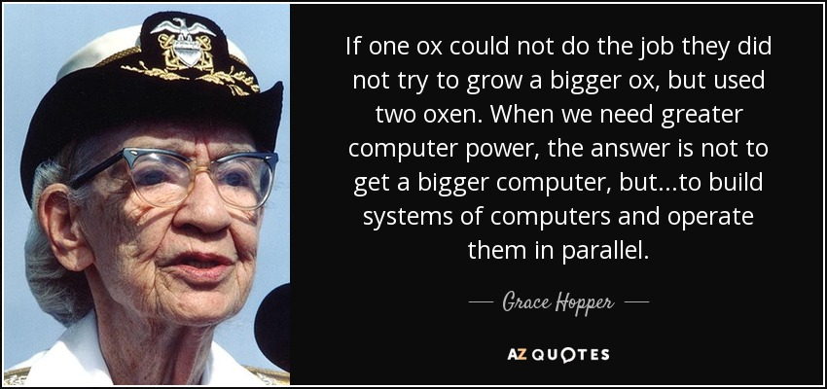
Grace Hopper

Slide 8

What is Spark?
Spark is an open source
in-memory
application framework for
distributed data processing and
iterative analysis
on massive data volumes
“Analytic Operating System”
Notes:
Spark isn't a data store as it has to connect to other relational, non relational data stores, as well as handling data at rest and data on the fly (streams of data Other than the doesn't’t have its own.
Spark isn't only for Spark is a separate stand-alone system or service
Spark isn't only for Hadoop as it can be used without Hadoop as well, and to process and analyze data sources in other data sources like DashDB, any relationship database, Cloudant, Cassandra and Amazon S3.
Spark isn't only for machine learning – Spark includes machine learning and does it very well, but it can handle much broader tasks equally well
Spark isn't a replacement for Streams – Spark Streaming is micro-batching, not true streaming, and cannot handle the real-time complex event processing that true streams do in version 1.6
IBM’s objective is that we offer our customers the power of Spark in whichever way they want to leverage it. So Spark and Hadoop coexist in our portfolio, and IBM is committed to advancing Hadoop and using Spark to enhance the value of the information inside of Hadoop. For existing BigInsights customers or Hadoop adopter customers, it’s not an either-or situation; Spark can be used to analyze information in Hadoop, exploiting the investments made to put data there. For existing BigInsights customers or Hadoop adopter customers, it’s not an either-or situation; Spark can be used to analyze information in Hadoop, exploiting the investments made to put data there.
True multi purpose MPP (Massively Parallel Platform)

Slide 9
IBM is All-in on Spark
"It's like Spark just got blessed by the enterprise rabbi."
Contribute to the Core
Launch Spark Technology Cluster (STC), 300 engineers
Open source SystemML
Partner with Databricks
Ben Horowitz,
Cofounder of Venture Capital
firm Andreessen Horowitz
Infuse the Portfolio
Foster Community
Integrate Spark throughout portfolio
3,500 employees working on Spark-related topics
Spark however customers want it – standalone, platform or products
Educate 1M+ data scientists and engineers via online courses
Sponsor AMPLab, creators and evangelists of Spark
Notes:
AMPLab – (Algorithms, Machines, People) at University of California, Berkeley
IBM Distribution is called IODPi
Spark as a service on bluemix

Slide 10
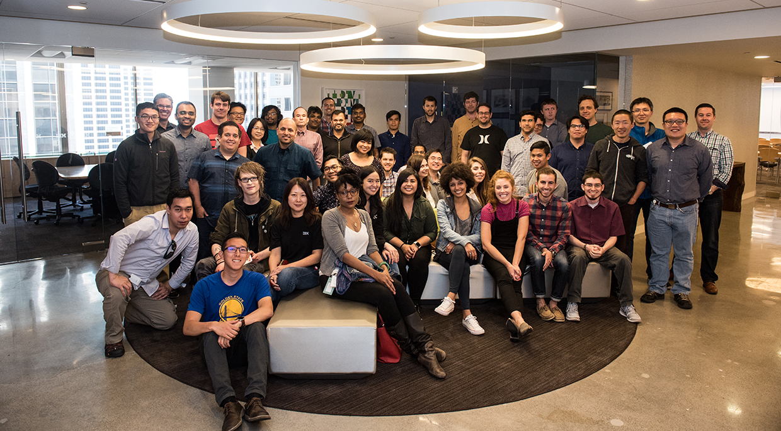
Contribute to the Core: Spark Technology Center
Notes:
Launched in June of 2015
Goal to Contribute to Apache Spark Apache community
Contributed SystemML technology to Apache community
STC continues to grow...

Slide 11
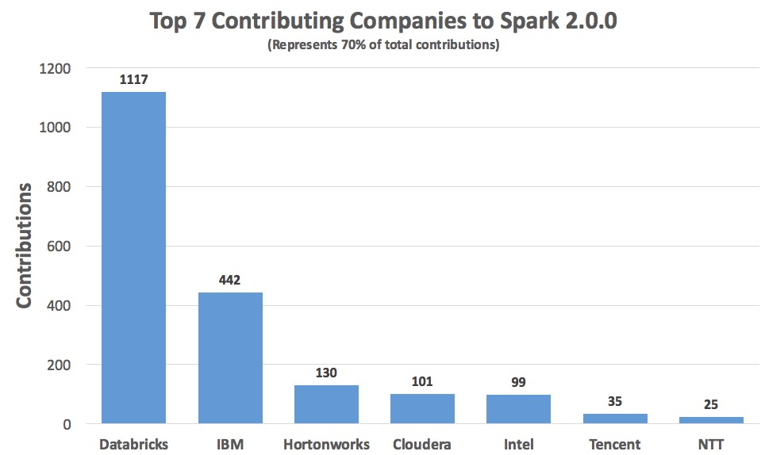
Contribute to the Core: Actual Code!

Slide 12
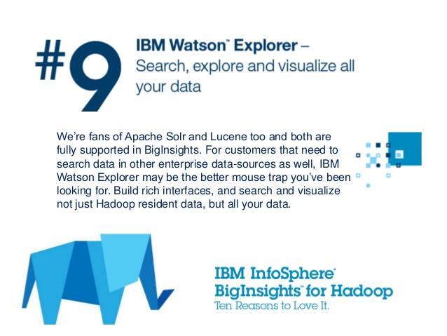
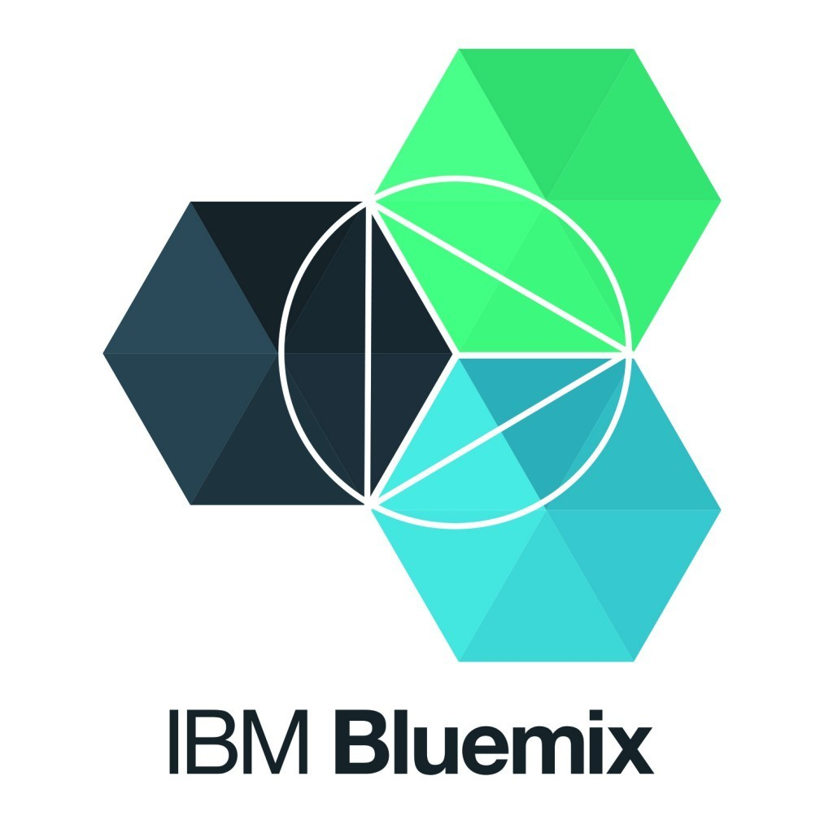
Infuse the Portfolio
Notes:
SPSS: https://developer.ibm.com/predictiveanalytics/2015/10/26/spark-integration-in-spss-modeler-17-1/
http://www.ibm.com/analytics/us/en/technology/cloud-data-services/spark-as-a-service/
https://www-03.ibm.com/press/us/en/pressrelease/47107.wss

Slide 13
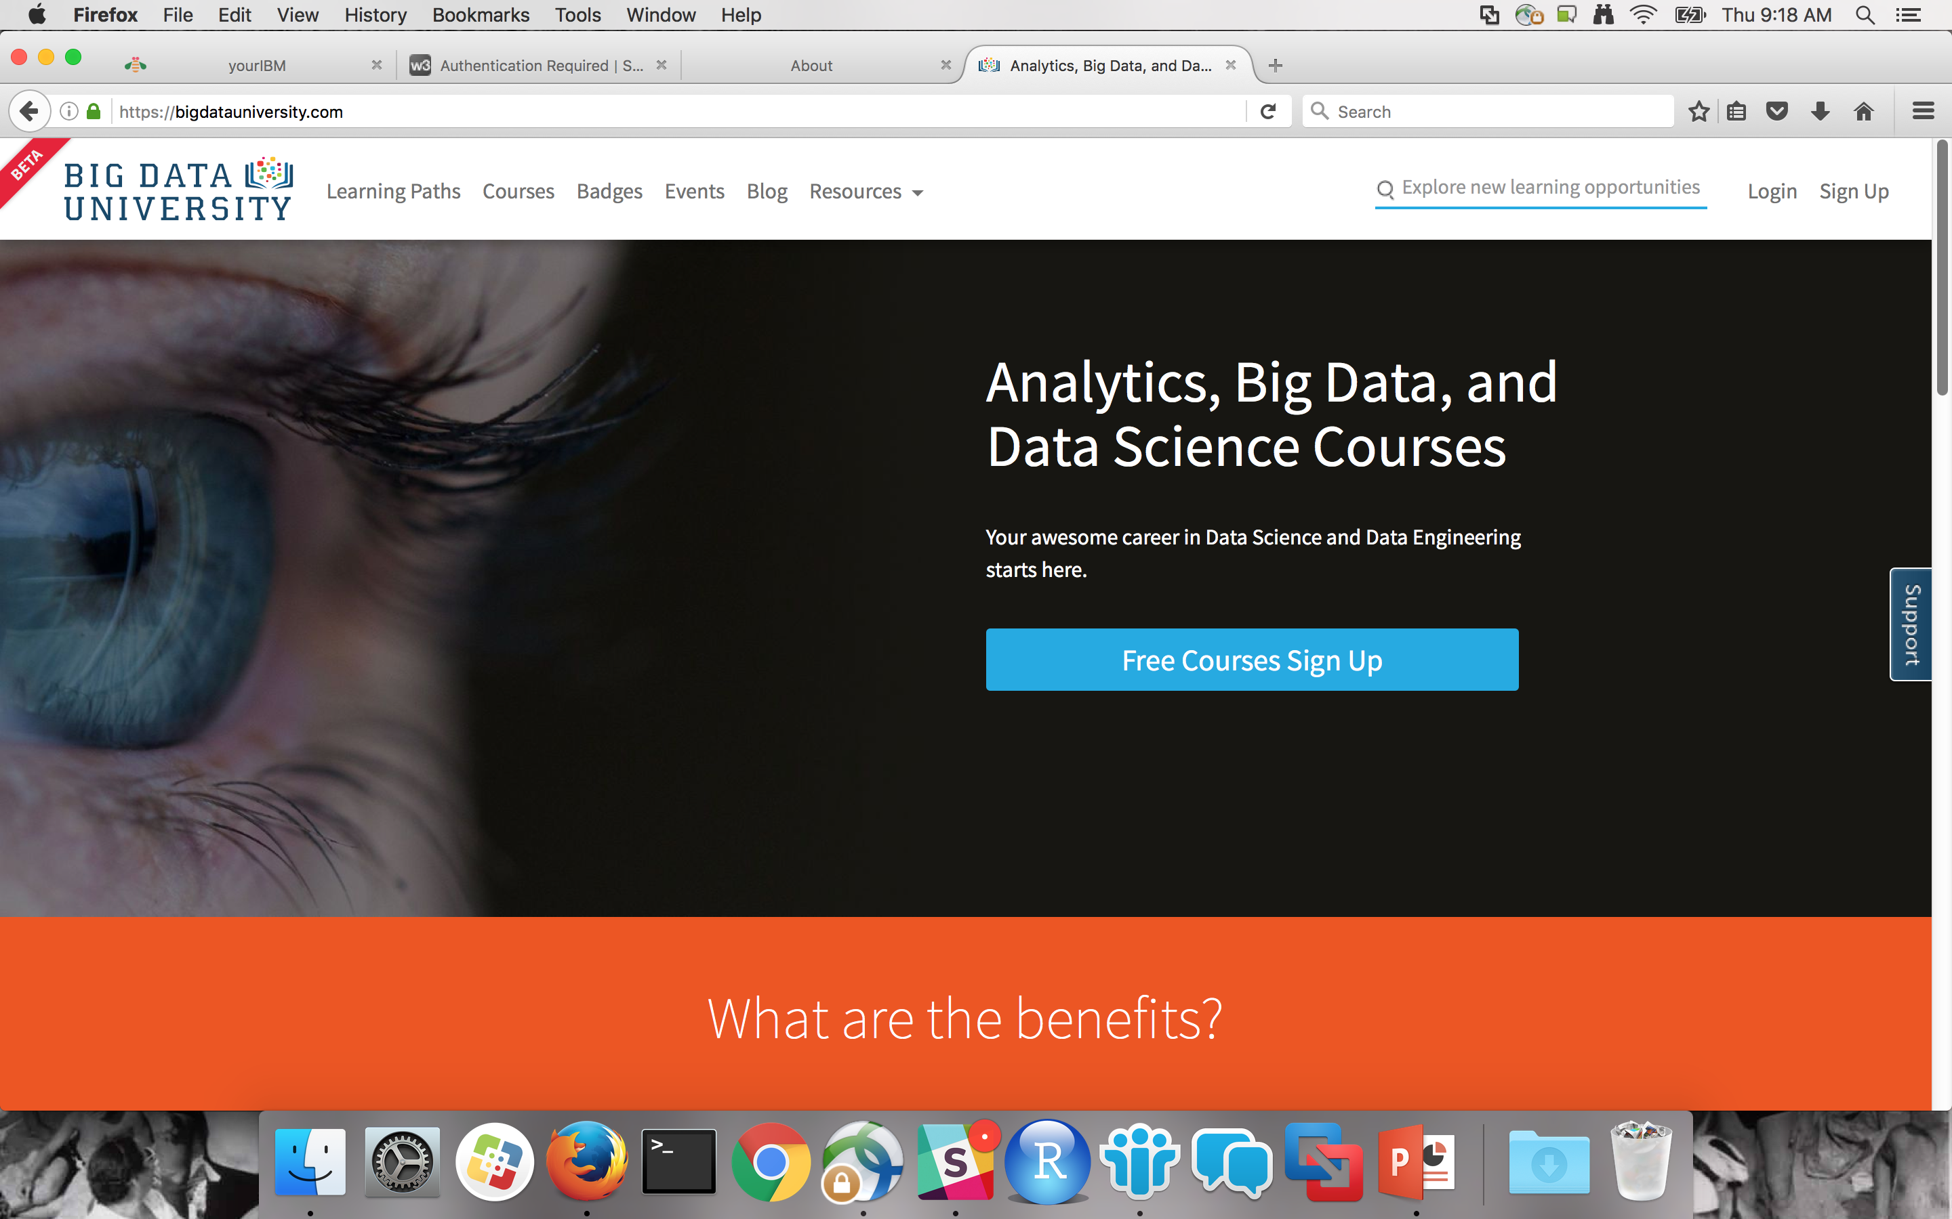
Foster the Community: Big Data University

Slide 14
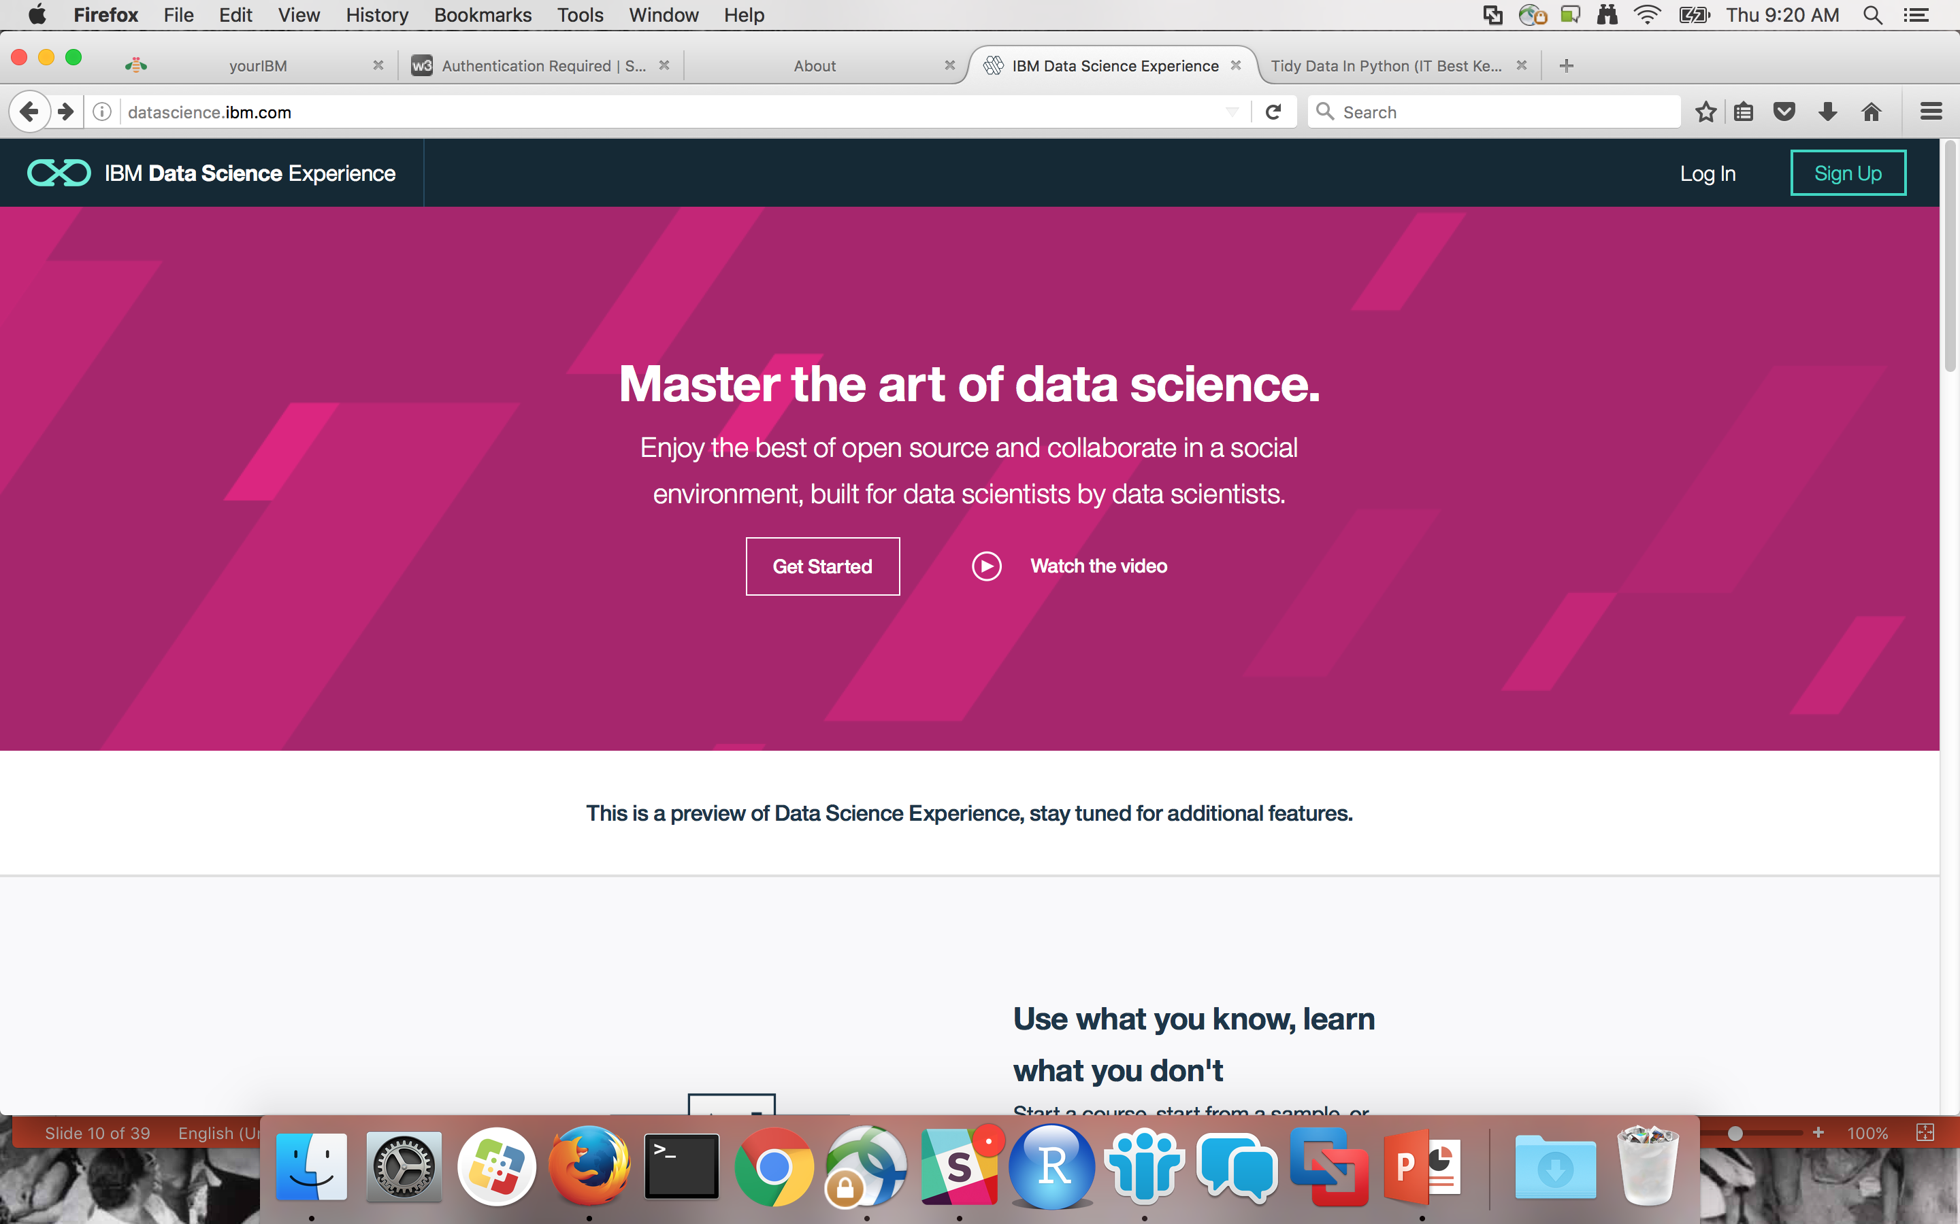
Foster the Community: Data Science Experience
Notes:
Talk much about the tool and preview it for the labs.

Slide 15
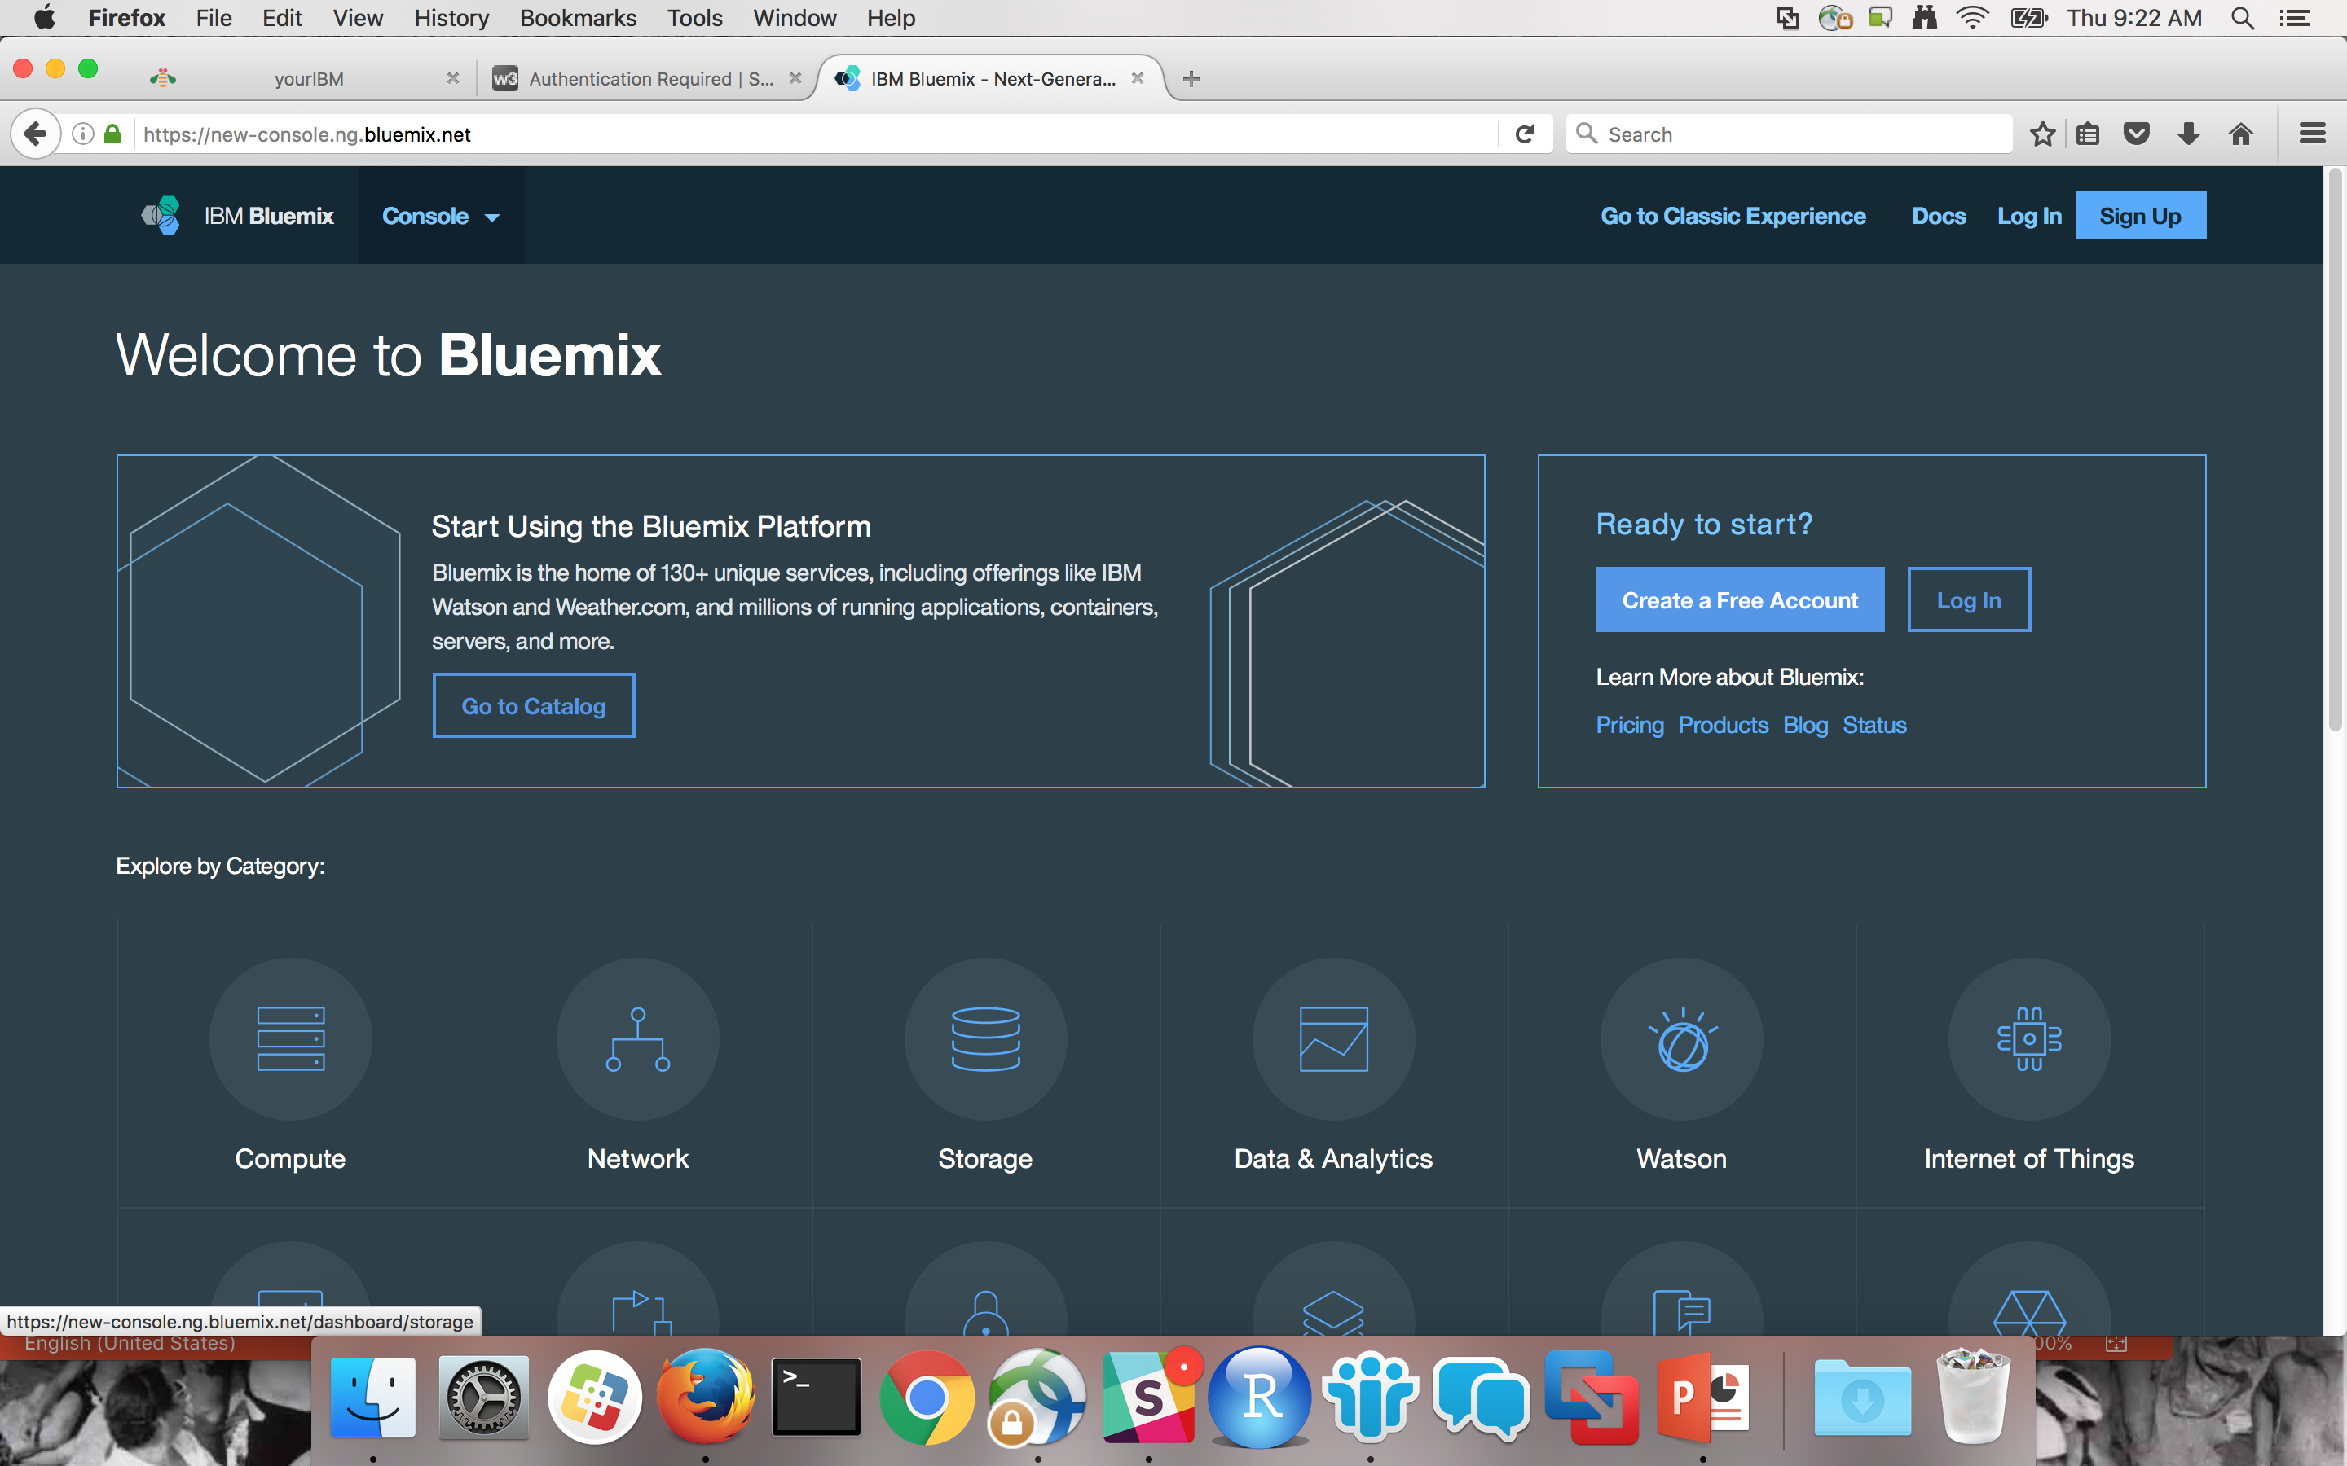
Foster the Community: Bluemix
Notes:
Say “You should have seen this in the email we sent asking you to sign up. We’ll go into more depth later when we talk about the labs”

Slide 16

Apache Spark Use Cases

Slide 17
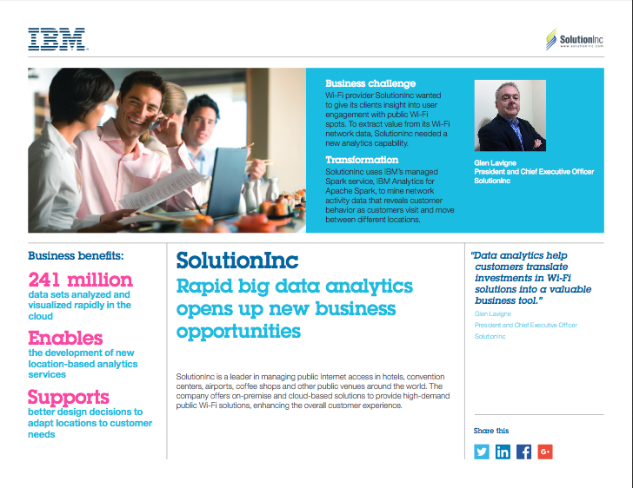
Use Case: SolutionInc
Notes:
https://www-01.ibm.com/software/ebusiness/jstart/portfolio/solutioninc.html

Slide 18
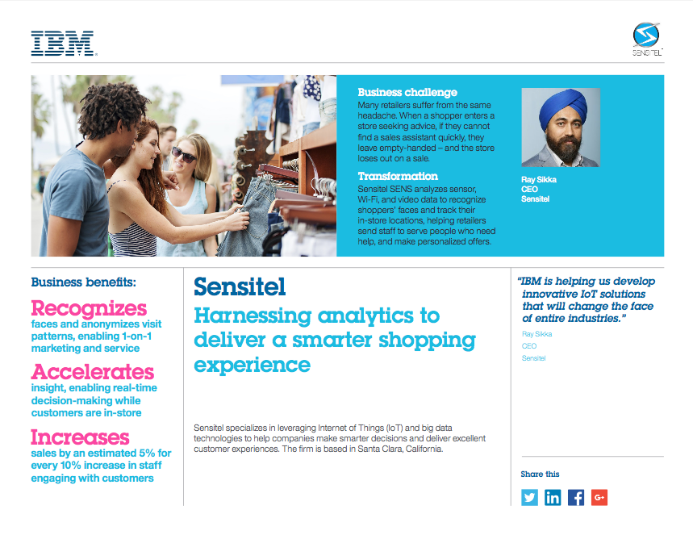
Use Case: Sensitel
Notes:
http://ecc.ibm.com/case-study/us-en/ECCF-WWC12356USEN

Slide 19

What is Apache Spark?

Slide 20

Introducing Apache Spark
General purpose distributed data processing engine
AMPLab at UC Berkeley
Started by Matei Zaharia in 2009
Creators founded Databricks
IBM partners with DB
Apache open source project
Initial release May 2014
Current version 2.0.2 released November 2016

Slide 21
Spark and the Key Libraries
Spark SQL
Spark SQL
Spark Streaming
Spark Streaming
MLlib Machine Learning
MLlib Machine Learning
GraphX Graphing
GraphX Graphing
Spark Core

Slide 22
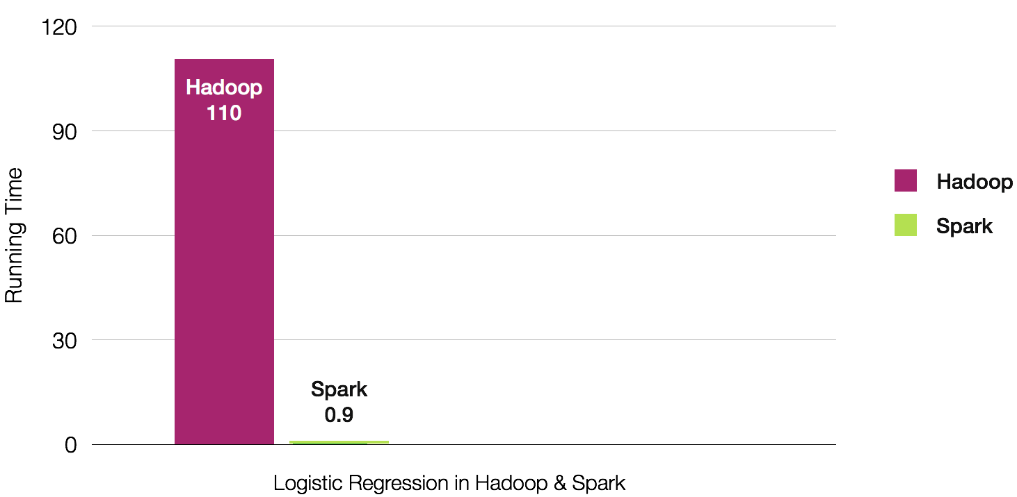
Why Spark? Performance

Slide 23
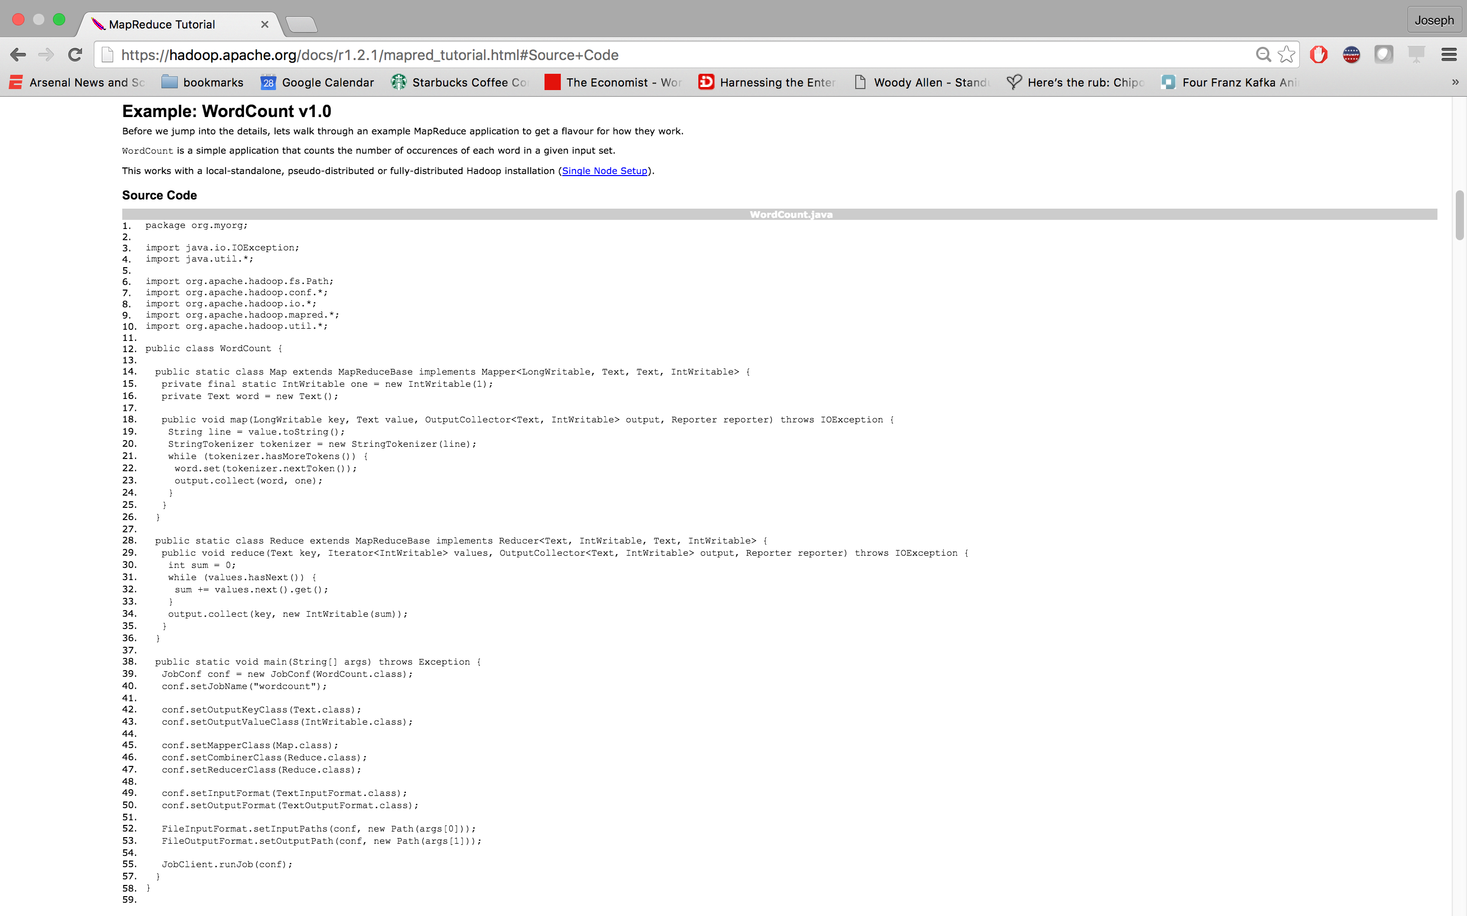
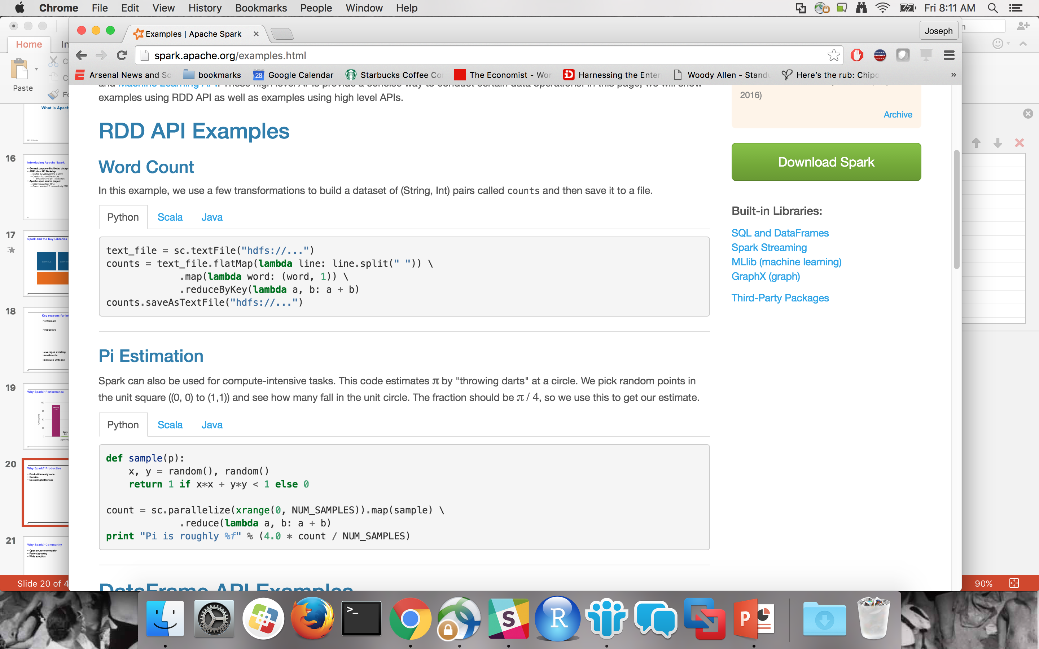
Why Spark? Productive
Production ready code
Concise
Focus on the business problems
and not coding
Notes:
Java Code: https://hadoop.apache.org/docs/r1.2.1/mapred_tutorial.html
Spark: http://spark.apache.org/examples.html

Slide 24
Why Spark? Community
Open source community
Fastest growing
Wide adoption
source: DataBricks 2016 Survey

Slide 25







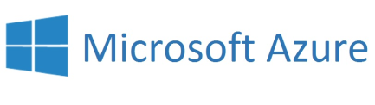







Why Spark? Ease of Use
Four APIs
Documentation
Data Platform Flexibility
Spark Core
Cloudant
dashDB
SQL DB
Object Storage
IBM CLOUD
OTHER CLOUD
CLOUD APPS
ON-PREMISE

Slide 26
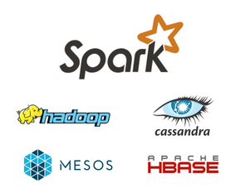
What Spark Is Not
Not only for Hadoop – Spark can work with Hadoop (especially HDFS), but Spark is a standalone system
Not a data store – Spark attaches to other data stores but does not provide its own
Not only for machine learning – Spark includes machine learning and does it very well, but it can handle much broader tasks equally well
Not real time – Spark Streaming is micro-batching, not true streaming, and cannot handle the real-time complex event processing
Notes:
Let’s talk about some of the misconceptions about Spark. Many people get confused on the difference between Hadoop and Spark, for that reason as we talk these points we’ll also discuss how they relate to Hadoop.
Spark does not require Hadoop to run. You can run Spark using its standalone mode or on Hadoop clusters through YARN, or on Apache Mesos.
Spark does not include a storage layer. You must provide a data store for Spark to access. Spark can access data in HDFS, Cassandra, Hbase, Hive, Tachyon, and any Hadoop data source.
You do not need to have a machine learning project to use Spark. Spark can manage complex analytics such as streaming or graphing data.
Spark does have a library for streaming, which can be useful for many use cases, however it is not true streaming. Spark Streaming process data streams in batches, where each batch contains a collection of events that arrived over the batch period (regardless of when the data were actually created). This is fine for some applications such as simple counts into Hadoop, but be aware that the lack of true record-by-record processes makes stream processing and time-series analytics impossible.

Slide 27

Apache Spark Programming

Slide 28
Spark Programming Languages
Scala
Functional programming
Spark written in Scala
Scala compiles into Java byte code
Python
Easily ports to Spark
Java
New features in Java 8 makes for more compact coding
R
Statistical language used to create and manipulate data
source: DataBricks 2016 Survey
Notes:
From Matei Zaharia presentation at IBM on Nov 2, 2015.
The Databricks survey also shows that the programming languages usage is changing. This is not to say that Scala is becoming less popular. It is likely because the type of people adopting Spark are coming more and more from a data science background which favors the use of Python and R.
A word of caution: Spark is written in Scala which is a language that compiles into Java byte code. This means that any functionality added to Spark Are automatically available in Scala (and likely Java). This is not the same for Python and R. On the bright side, the functionality gap between the languages is shrinking. We may get to a point where the differences wont matter.

Slide 29
Functional Programming
Spark depends on functional programming
Closures or in line anonymous functions
Functions have inputs and outputs only
One can pass functions as inputs to other functions as parameters
Python
function(lambda x: x)
Scala
function(x => x)

Slide 30
Resilient Distributed Dataset (RDD)
Immutable
Holds references to partition objects
Each partition is a subset of the overall data
Partitions are assigned to nodes on the cluster
Partitions are in memory by default
Fault tolerance
If data in memory is lost it will be
recreated from lineage
Partition
Memory
partition
RDD
Array
Partition
Memory
partition
Partition
Memory
partition
Partition
Memory
partition
Notes:
This slides shows the main characteristics of an RDD.
An RDD cannot be modified. Any transformation on an RDD will result is a new RDD. An RDD resilience lies in the fact that it keeps track of where it came from so if an RDD is lost for any reason, it can Be reconstructed from one of its ancestors. This chain of modifications is referred to as lineage.
The key to parallel processing in Spark is the partitioning of an RDD. For example, if an RDD comes from an HDFS file, it will be partitioned based on the number of blocks available. There are transformations in Spark that allows to repartition an RDD to improve the overall Performance by either increasing or even decreasing the number of partition.
In general RDD partitions are kept in memory but parameters can be set to allow for spilling to disk if needed. In the execution of a Spark application, multiple RDDs are created since RDDs are immutable. This means that the memory Requirements can be much greater than the size of the input file. For this reason, RDDs can be removed during the processing. If they happen to be needed later, they can be recreated from their lineage. To help performance, it is possible to “persist” an RDD so it would not have to be re-created.
Rdd operations count, means, sum, max, min, variance….

Slide 31
DataFrames
Subset of RDDs
Main data object abstraction in SparkSQL
Organized into NAMED columns
Can be created from:
Existed structured data source
json, database table, Apache Parquet
Another RDD
Transformation of another dataframe
Programmatically

Slide 32
More about RDDs and DFs
Two types of operations
Transformations
map()
filter()
flatMap()
Actions
first()
collect()
take()
Lazy evaluation

Slide 33

Apache Spark Code Execution

Slide 34
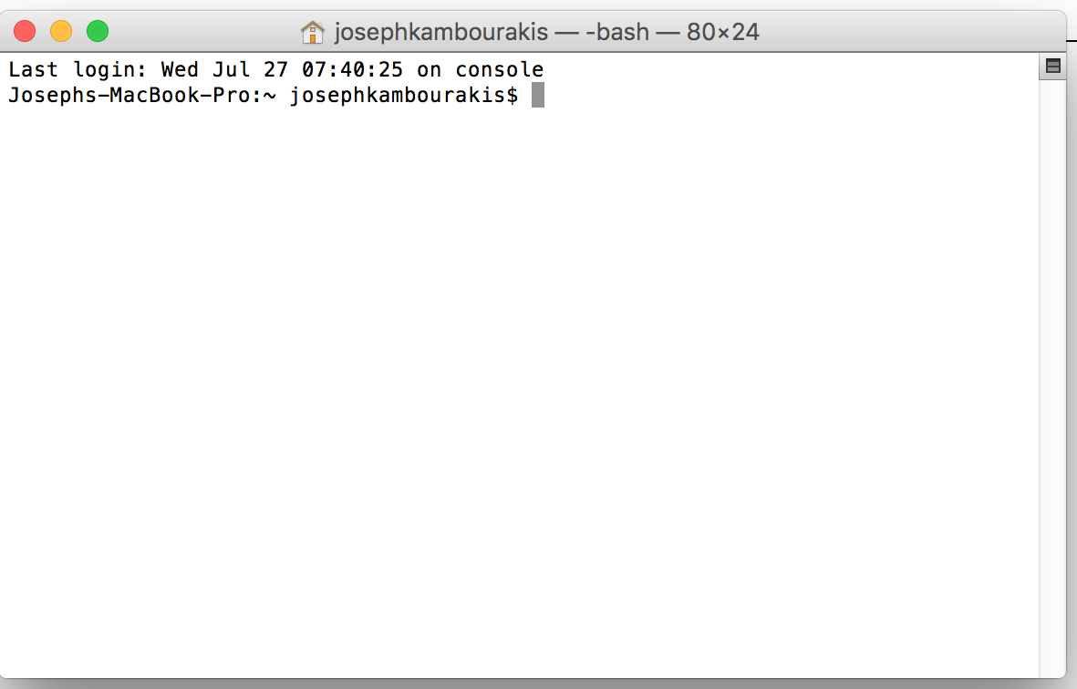
Directed Acyclic Graph - DAG
File
RDD1
RDD2
textFile()
map()
filter()
collect()
RDD3

Slide 35
Sample Code
RDD1 = sc.textFile(data.txt)
RDD2 = RDD1.map(lambda line: line.upper())
RDD3 = RDD2.filter(lambda line: 'CHARLIE' in line)
RDD3.collect()
File: data.txt
RDD1
RDD2
RDD3
Of all the Charlie Browns in the world, you’re the Charlie Browniest.
Happiness is a warm puppy
In the book of life, the answers aren’t in the back
Awkward is my specialty.
You know, Charlie Brown, they say we learn more from losing than from winning.
...
Of all the Charlie Browns in the world, you’re the Charlie Browniest.
Happiness is a warm puppy
In the book of life, the answers aren’t in the back
Awkward is my specialty.
You know, Charlie Brown, they say we learn more from losing than from winning.
...
OF ALL THE CHARLIE BROWNS IN THE WORLD, YOU'RE THE CHARLIE BROWNIEST
HAPPINESS IS A WARM PUPPY
IN THE BOOK OF LIFE, THE ANSWERS AREN'T IN THE BACK
AWKWARD IS MY SPECIALTY
YOU KNOW, CHARLIE BROWN, THEY SAY WE LEARN MORE FROM LOSING THAN FROM WINNING
...
OF ALL THE CHARLIE BROWNS IN THE WORLD, YOU'RE THE CHARLIE BROWNIEST
YOU KNOW, CHARLIE BROWN, THEY SAY WE LEARN MORE FROM LOSING THAN FROM WINNING
...

Slide 36

Apache Spark Under the hood!

Slide 37

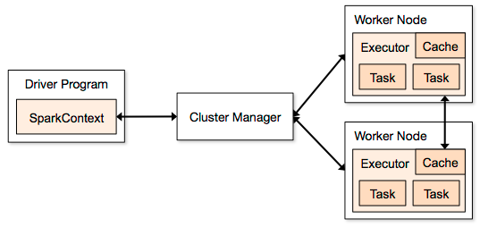
Spark Application Architecture
A Spark application is initiated from a driver program
Spark execution modes:
Standalone with the built-in cluster manager
Use Mesos as the cluster manager
Use YARN as the cluster manager
Standalone cluster on any cloud (BlueMix, IBM Softlayer, Amazon, Azure, …)
Notes:
Leverage Jacques slides 10-14 for this section
The key to spark processing is still to have a distributed file system so all the file operations, including I/O can be done in parallel.
A Spark application is initiated by a driver program that eventually uses executors to execute tasks that represent the processing of a directed graph. More on directed graphs in a few slides.
RDD / Data Frame (abstraction of an RDD). RDD spread across all nodes (Spark – query optimizer for a map and reduce job creates a query plan which is broken into 1 or more tasks. Just like a DBMS cost base optimizer. For Example – word count , returned and summed. More complicated shuffling data. Deck of cards shuffled and spread across multiple nodes and count each node, and then do a summary across nodes (Massively Parallel Problem) . Ordered list by suit – may require shuffling data to organize it by suit or provide a proper order. Cluster manager does summarization
Terminology ▪Context (Connection): Represents a connection to the Spark cluster. The Application which initiated the context can submit one or several jobs, sequentially or in parallel, batch or interactively. ▪Driver (Coordinator agent) The program or process running the Spark context. Responsible for running jobs over the cluster and converting the App into a set of tasks ▪Job (Query / Query plan): A piece of logic (code) which will take some input from HDFS (or the local filesystem), perform some computations (transformations and actions) and write some output back. ▪Stage (Sub plan) Jobs are divided into stages ▪Tasks (Sub section) Each stage is made up of tasks. One task per partition. One task is executed on one partition (of data) by one executor ▪Executor (Sub agent) The process responsible for executing a task on a worker node
Spsrk talks thru spss analytics server to get to the cluster manager
2 collaborators uploaded
Most recently uploaded February 21, 2016 at 6:10 PM by BRUCE FISCHER

Slide 38
Showing multiple applications
Each Spark application runs as a set of processes coordinated by the Spark context object (driver program)
Spark context connects to Cluster Manager (standalone, Mesos/Yarn)
Spark context acquires executors (JVM instance)
on worker nodes
Spark context sends tasks to the executors
Worker Node
Executor
Cache
Task
Task
Driver Program
Cluster Manager
App
SparkContext
Worker Node
Executor
Cache
Task
Task

Slide 39

Apache Spark Libraries

Slide 40
SparkSQL
Component of Spark
Project started in 2012
First alpha release in Spring 2013
Out of alpha with Spark 0.9.0
New features in Spark 2.0
Allows you to interact with Apache Hive
More in next section!
Notes:
Spark Streaming is an extension of the core Spark API. The project was started in 2012, released as alpha in the spring of 2013. It came out of alpha with the Spark 0.9.0 release in February 2014.
It defines a new abstraction: Discretized Streams or DStreams. DStream represents a sequence of RDDs where each RDD is a collection or records that accumulated within a specific time interval.
Just like Spark, it supports Scala, Java and, with limitations, Python.
We have to understand that Spark Streaming is a construct that depends on Spark. Spark Streaming consists of the submissions of Spark jobs at specific intervals. So in this context, as the submission rate increases, it becomes a higher percentage of the overall processing load.

Slide 41
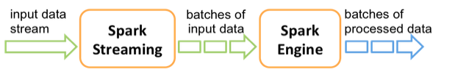
Spark Streaming
Component of Spark
Project started in 2012
First alpha release in Spring 2013
Out of alpha with Spark 0.9.0
New features in Spark 2.0
Discretized Stream (DStream) programming abstraction*
Represented as a sequence of RDDs (micro-batches)
RDD: set of records for a specific time interval
Supports Scala, Java, and Python (with limitations)
Fundamental architecture: batch processing of datasets
Notes:
Spark Streaming is an extension of the core Spark API. The project was started in 2012, released as alpha in the spring of 2013. It came out of alpha with the Spark 0.9.0 release in February 2014.
It defines a new abstraction: Discretized Streams or DStreams. DStream represents a sequence of RDDs where each RDD is a collection or records that accumulated within a specific time interval.
Just like Spark, it supports Scala, Java and, with limitations, Python.
We have to understand that Spark Streaming is a construct that depends on Spark. Spark Streaming consists of the submissions of Spark jobs at specific intervals. So in this context, as the submission rate increases, it becomes a higher percentage of the overall processing load.

Slide 42
Spark MLlib
Spark MLlib for machine learning library
Provides common algorithm and utilities
Classification
Regression
Clustering
Collaborative filtering
Dimensionality reduction
Leverages iteration and yields better results than one-pass approximations sometimes used with MapReduce
More on this later!
Notes:
Clustering Recommendation Engines
Machine Learning came from IBM Research
It divides into two packages: spark.mllib contains the original API built on top of RDDs. And spark.ml provides higher-level API built on top of DataFrames for constructing ML pipelines.
http://spark.apache.org/docs/latest/mllib-guide.html
Classification – decision trees , linear regression, logistics
Regression -
Clustering
Collaborative Filtering – Recommendation

Slide 43
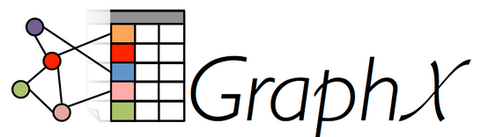
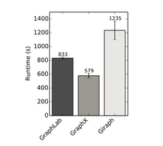
Spark GraphX
Scala only!
Flexible Graphing
GraphX unifies ETL, exploratory analysis, and iterative graph computation
You can view the same data as both graphs and collections, transform and join graphs with RDDs efficiently, and write custom iterative graph algorithms with the API
GraphFrames - graph library based on Data Frames
Speed
Comparable performance to the fastest specialized graph processing systems.
Algorithms
Choose from a growing library of graph algorithms
In addition to a highly flexible API, GraphX comes with a variety of graph algorithms
Notes:
Check release of Graph Frames
Documentation http://spark.apache.org/docs/latest/graphx-programming-guide.html
Extenstion to the rdd api and is a common graph algorithm used for page ranking or triangulation

Slide 44

Apache Further Resources

Slide 45
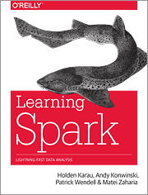
Additional Resources

Slide 46
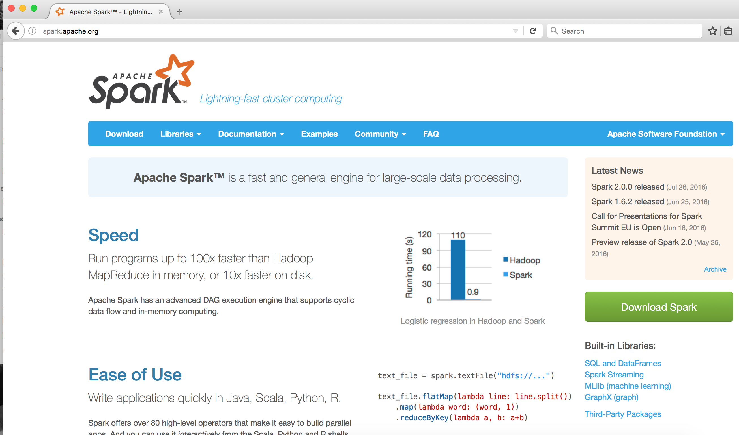
Additional Resources

Slide 47
Intro to lab
Data Science Experience
Jupyter Notebook
Student Code
Solutions will be provided after the lab and we'll walk through them.

Slide 48
Links to Material
Box
https://ibm.box.com/v/SparkPoT
Github
https://github.com/JosephKambourakisIBM/SparkPoT

